Slide 1
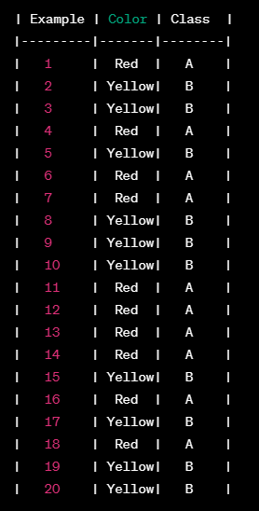
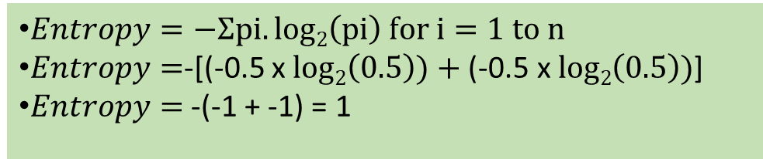
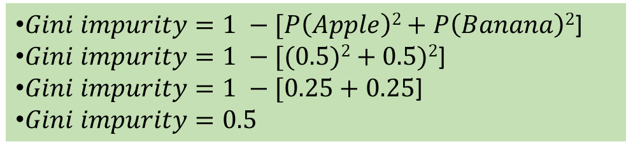
Gini Index/Coefficient/Impurity
P(Apple) = 10/20 = 0.5
P(Banana) = 10/20 = 0.5
Gini impurity is sometimes used instead of entropy (Lower the better, 0 is the best)
Example: Predict fruit (A=Apple, B=Banana)
$Entropy=−Ʃpi.log2\left(pi\right) for i=1 to n$
$Entropy=$-[(-0.5 x $log2\left(0.5\right))+\text{(−0.5 }\text{x} log2\left(0.5\right))$]
$Entropy=$ -(-1 + -1) = 1
$Gini impurity=1 −[P\left(Apple\right)2+P\left(Banana\right)2$]
$Gini impurity=1 −[(0.5)2+0.5)2$]
$Gini impurity=1 −[0.25+0.25$]
$Gini impurity=0.5$

Slide 2
When We Have More Classes
Consider we have three classes with probabilities of 0.4, 0.4, and 0.2 respectively
Gini impurity = 1 - (p1^2 + p2^2 + p3^2)
Gini impurity = 1 - (0.4^2 + 0.4^2 + 0.2^2)
Gini impurity = 1 - (0.16 + 0.16 + 0.04)
Gini impurity = 1 - 0.36
Gini impurity = 0.64
Conclusion: More classes, higher Gini impurity

Slide 3
Simulation and Risk Analysis

Slide 4
Monte Carlo Simulation
Monte Carlo Simulation is a statistical technique, which is used to estimate the possible outcomes of an uncertain event
Named after the Monte Carlo Casino in Monaco (an independent country next to a city called Nice in the south of France) because of the element of chance involved
Used when it is impractical or impossible to compute the exact solutions to a problem analytically
What-If analysis

Slide 5
Linear Programming Problem (LPP)

Slide 6
What is Linear Programming Problem (LPP)?
The Linear Programming Problem (LPP) is concerned with finding the optimal value of the given linear function
The optimal value can be either maximum value or minimum value
Also called optimization problem

Slide 7
Linear Programming Problem (LPP)
In any business, the aim is to maximize profit or minimize cost
Written as Max z or Min z
Example: z = x + 2y will be called as an objective function
Every business has constraints
Example: 2x + 3y >= 5
All resources are positive
x, y >= 0 (e.g. time, money)
This is called Linear Programming Problem (LPP)
Objective function
+
Constraints
=
Linear Programming Problem

Slide 8
LPP in Python
We can use the PuLP library (pip install pulp)
Problem statement: A furniture company produces a variety of products. One department specializes in wood tables, chairs, and bookcases. These are made using three resources: labor, wood, and machine time. The department has 60 hours of labor available each day, 16 hours of machine time, and 400 board feet of wood. Each table contributes $40 profit, chair $30 and bookcase $45. Each table takes 2 hours of labor, 50 minutes of machine time and 30 board feet of wood. For chair these are: 1 hour, 40 minutes, and 20 board feet. For a bookcase these are: 2.5 hours, 60 minutes, and 30 boards feet.
Develop a linear programming model for the department.

Slide 9
LPP Formulation – Part 1
Variables:
x1= quantity of tables
x2= quantity of chairs
x3= quantity of bookcases
To manufacture one unit of | Table (x1) | Chair (x2) | Bookcase (x3) | Total availability for the day
Labor time in hours | 2 | 1 | 2.5 | 60
Machine time in hours | 50 minutes = 0.80 hours | 40 minutes = 0.6 hours | 1 hour | 16
Wood in feet | 30 | 20 | 30 | 400
Hence, Constraints
labor: 2 * x1 + 1 * x2 + 2.5 * x3 <= 60 Hours
Machine: 0.8 * x1 + 0.6 * x2 + 1.0 * x3 <= 16 Hours
Wood: 30 * x1 + 20 * x2 + 30 * x3 <= 400 board-feet

Slide 10
LPP Formulation
Objective Function: Profit = 40*x1+30*x2+45*x3
x1, x2, x3 >= 0

